Slide 1

Case analysis contest
Presentation by:CS batch-3(L4)
Thaspeeha
Laiba
Sumaiya

Slide 2

Introduction
The presentation comprises of ideas with a view to improvise the PayIt app after a deep analysis . The probe mainly focus on design of the app ,visual identity, marketing strategies and social impacts.
Also, a UI design for improving the visual representation of the app is added.

Slide 3
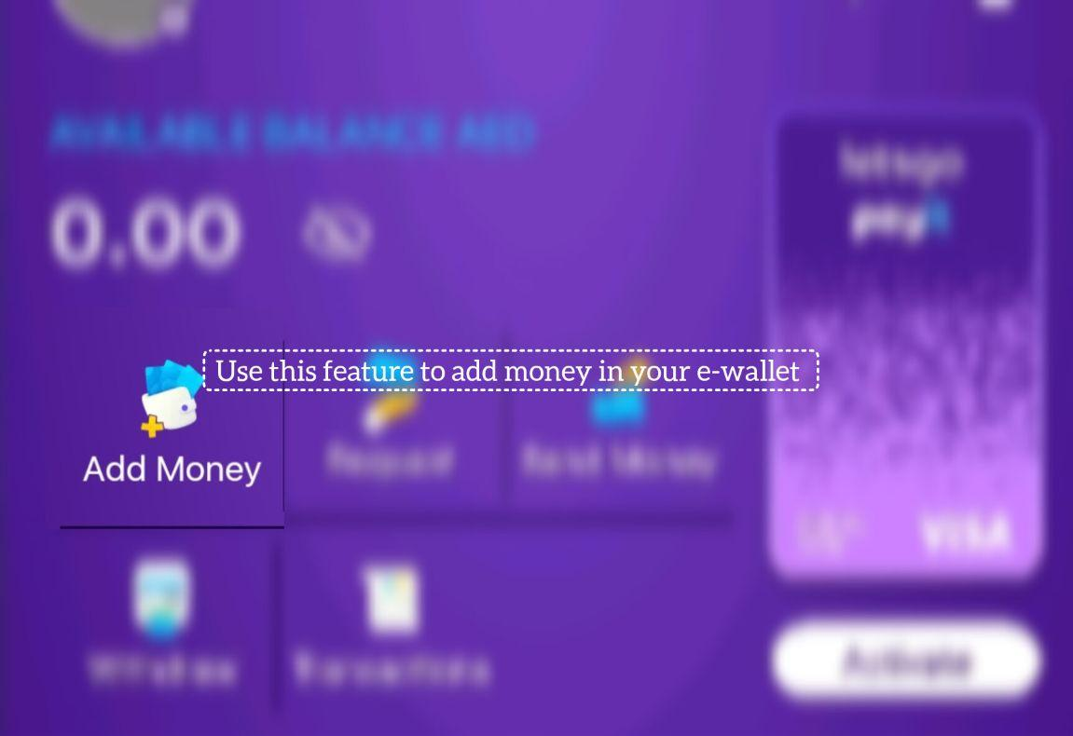
Scheme 1: Adding step-by-step guide on how to use the app
The app is well built yet the functioning of the app and its features aren’t well executed. It is recommended to add a tutorial video on SNS or a feature which guides the novice user/client on how to use the app and what features it has. Also, a short but precise description on each features is highly suggested.

Slide 4
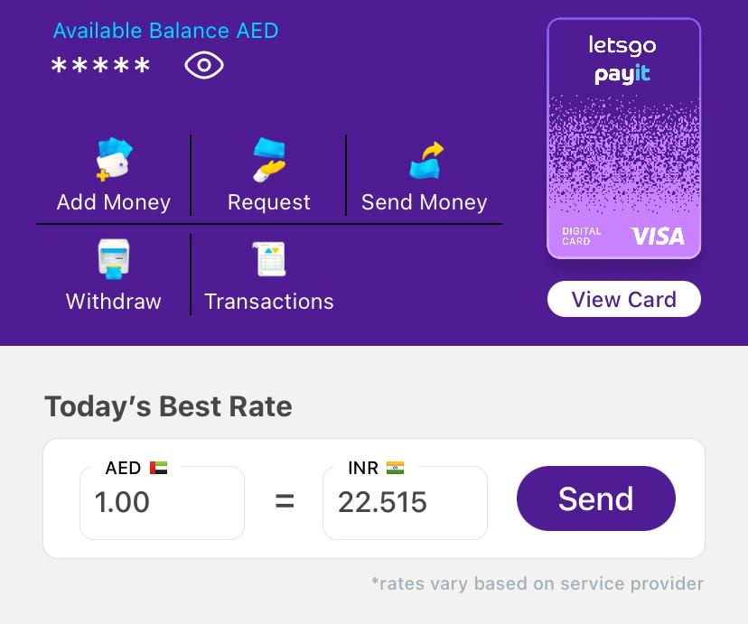
Scheme 2: Improving the UI/UX design
The UI can be improved to allow for a more easy and accessible way of navigating the app. The following ways can be used to achieve this:
There can be a smoother transitioning when navigating between pages, which will make the user experience more fulfilling.
The app should use allow changing of the font size to make it more accessible for people who have trouble reading small fonts.
The format should allow for more space between the different services, which are a little congested and can make it hard for some people to navigate.
The small font and cramped space can make the app hard to use.

Slide 5
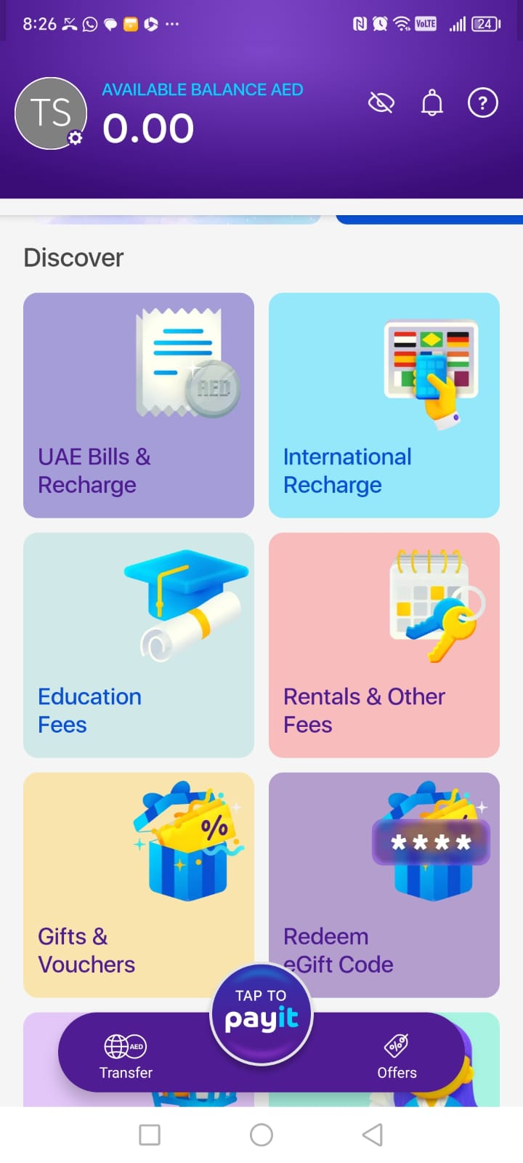
Scheme 3: Visual identity and branding
First we can talk about branding which personalized user app experience for PayIt but missing on the most important part which is to make it a real brand. The app has to conduct a lot of schemes to metabolize the customer care service or surveys to understand what social media tools they can use to expose the app to everyone internationally.
Second is visual identity in payit.
The following additional features can be added for users to meet their day-to-day needs:
1) Offers:
Make the users to recommend what offers they can use while doing any kind of payments.
2) Commercial activities – vat or tax return payments.

Slide 6
3) For money transfers:
Set an animation or a visual to entertain the users on how the money is transferred from an account to other.
4) Recharge
Nol card (used in RTA bus,Metro,Dubai public parks,Etihad museum,Abrar service,cruise,ferry,etc)
Nol means ‘fare’ in Arabic is a smart card thoughtfully created by RTA Dubai. It can be used for transportation, restaurants, petrol stations, pharmacies, parking areas just by tapping your card. (Types: red, blue, gold, silver).
5) UAE Bills
Concert Tickets and Desert Safari, movie tickets, charity payments, online shopping payments.
(Can collaborate with Platinum ticket purchases platform)

Slide 7
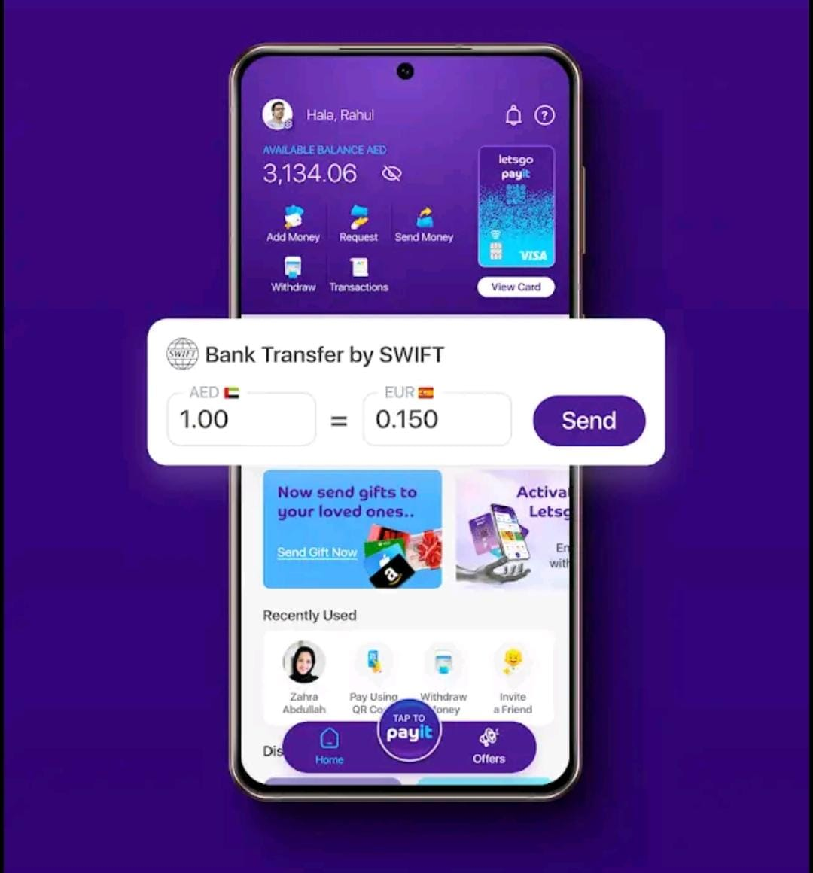
6) Household bills
Electricity, water, renewals, vehicles and health insurance, rent a car.
7) Decrease the visual images to easily seen by users once they login into the app.
8) Set a list of rates in UAE adding with travel deals.
Ex: Metro, Flight.

Slide 8
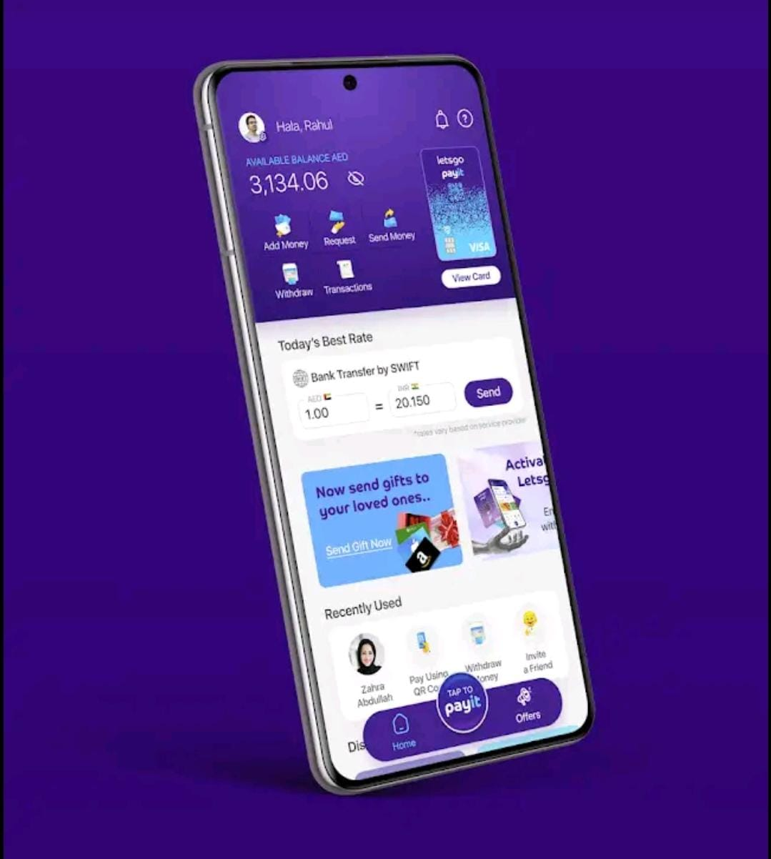
Scheme 4: Social impacts and financial inclusion
Social impact is an important aspect that needs attention as it helps bringing further improvement in the app and services. Some of the complaints/reviews shared include:
Slow customer service and lack of information.
Sending money locally takes excessive long time.
Can’t change the amount while doing bill payments.

Slide 9
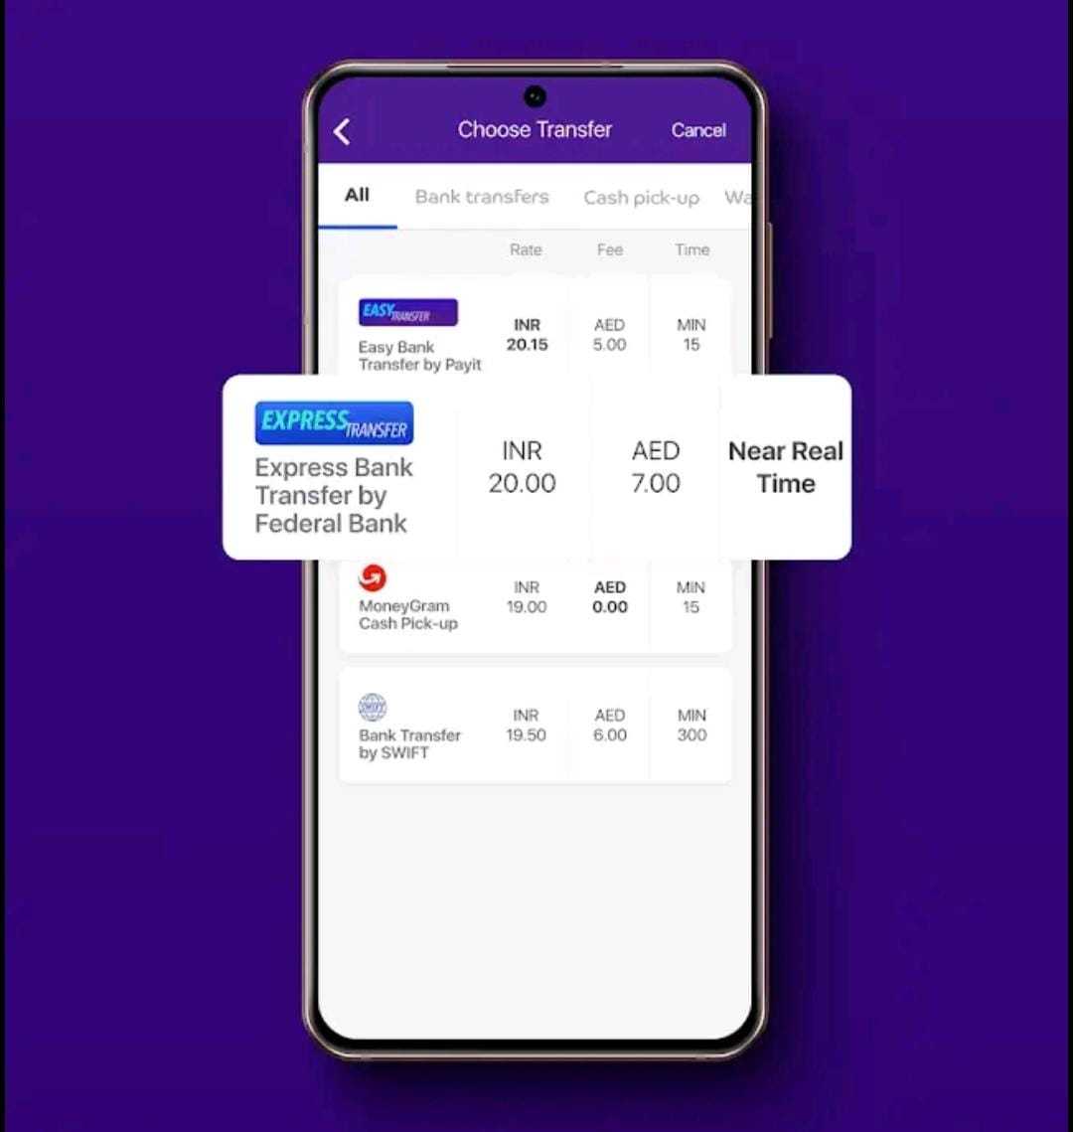
Financial inclusion :
Adding beneficiary which is a savings account a person designated to receive the benefits and funds of your account, estate or policies in the event of your death.
Bank accounts, life insurance, retirement accounts, assets, etc.

Slide 10
Scheme 5: Marketing and Communication strategy
“Communication is the key”
The motive of e-wallet is new and is unusual to many users/customers. Many are unaware of this advanced progress that has been established. Promoting the PayIt app through SNS, ads, influencers or direct marketing is highly recommended in order to reach high number of users and ensuring that they are able to take advantage of the app precisely and feel secure.
Along with promoting it is also important to reach/respond to the users whenever they have doubts or confusion regarding the app or is need of technical help as it increases the chance of an user to recommend others about the app.

Slide 11
The end

